Slide 1
LLM-based Code Deobfuscation for JavaScript
Jiayi Hua
2024.5.30

Slide 2
1
LLM + reverse engineering
LLM-based Code Deobfuscation for JavaScript
2

Slide 3
1
LLM + reverse engineering
LLM-based Code Deobfuscation for JavaScript
2

Slide 4
LLM + reverse engineering
Reverse engineering is challenging
Hard to revert machine code to source code
Code obfuscation
Code packing and encryption
Dynamic code generation
Anti-debugging techniques
Hardware-based protections
……
Notes:
TEE

Slide 5
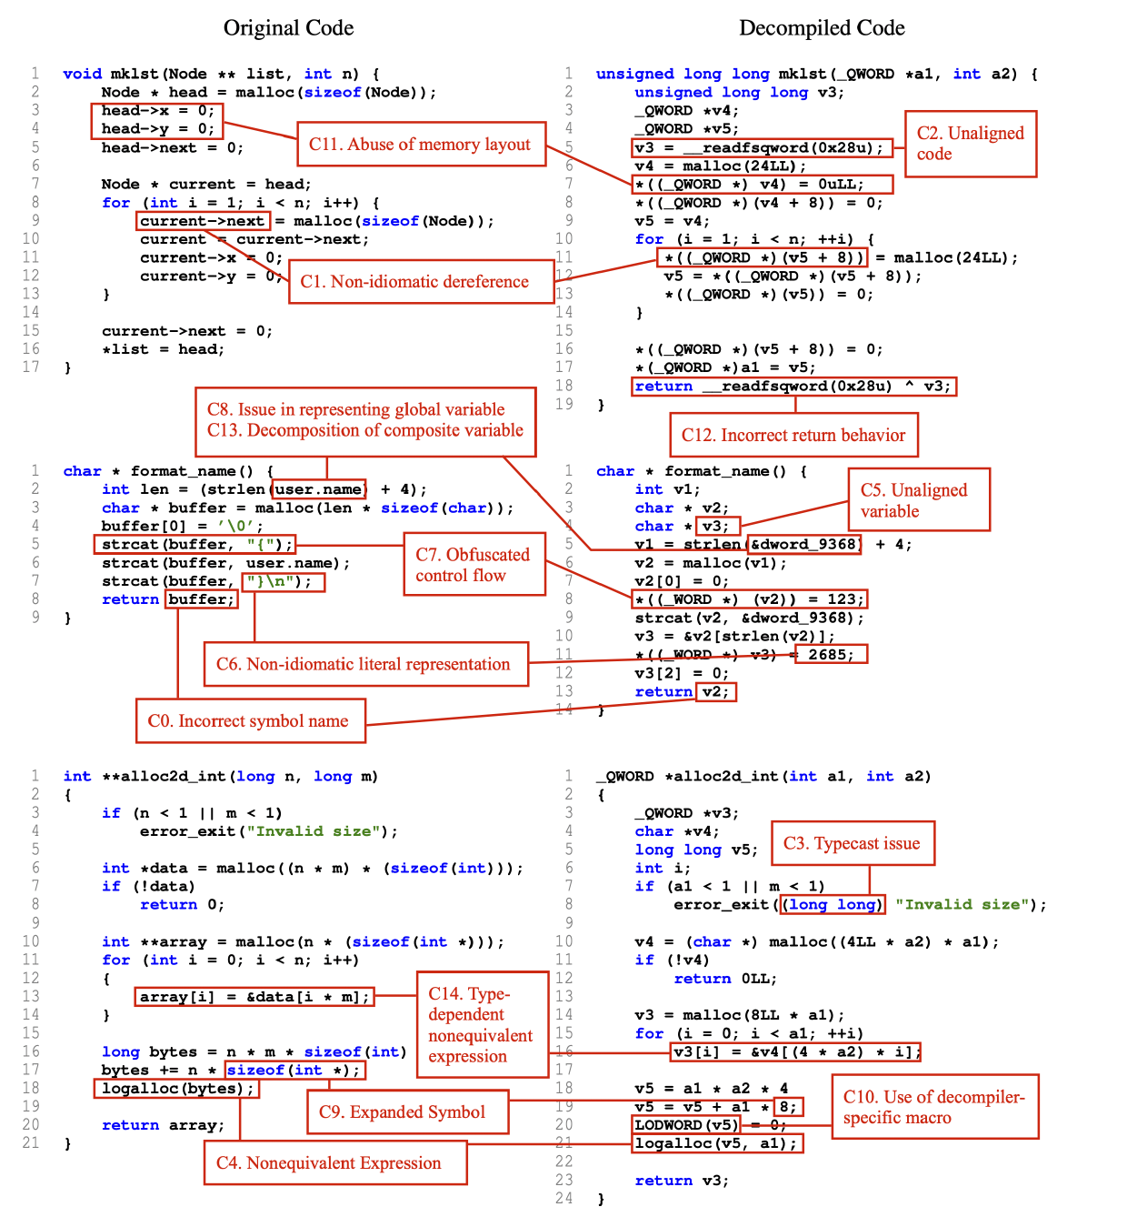
LLM + reverse engineering
Correctness issues: semantic difference between the decompiled code and the corresponding original code
Readability issues: semantically equivalent but is communicated using different language features that are difficult to interpret.
Dramko, Luke, Jeremy Lacomis, Edward J. Schwartz, Bogdan Vasilescu, and Claire Le Goues. "A Taxonomy of C Decompiler Fidelity Issues." (usenix security 2024)

Slide 6
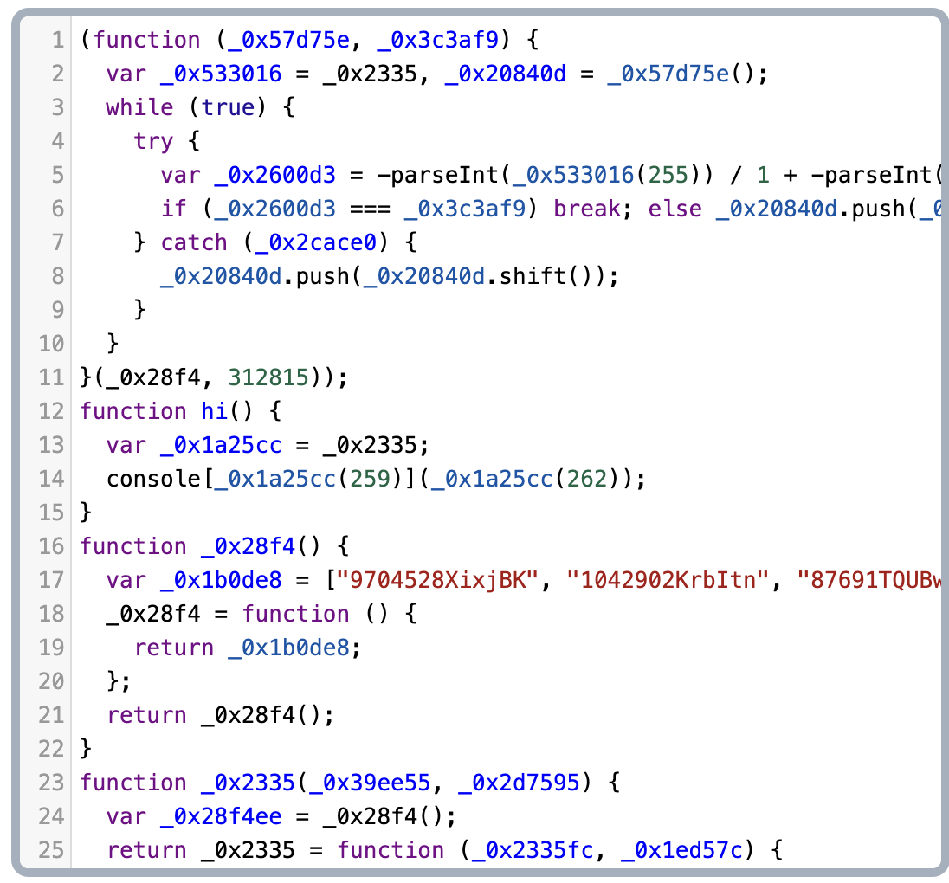
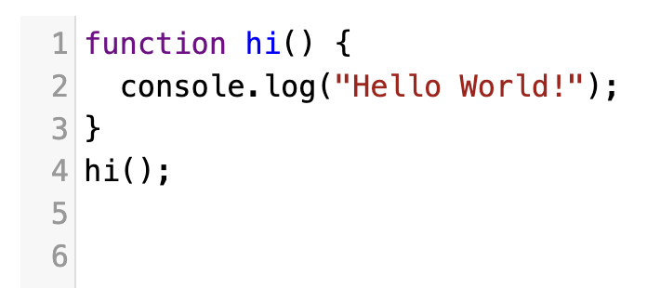
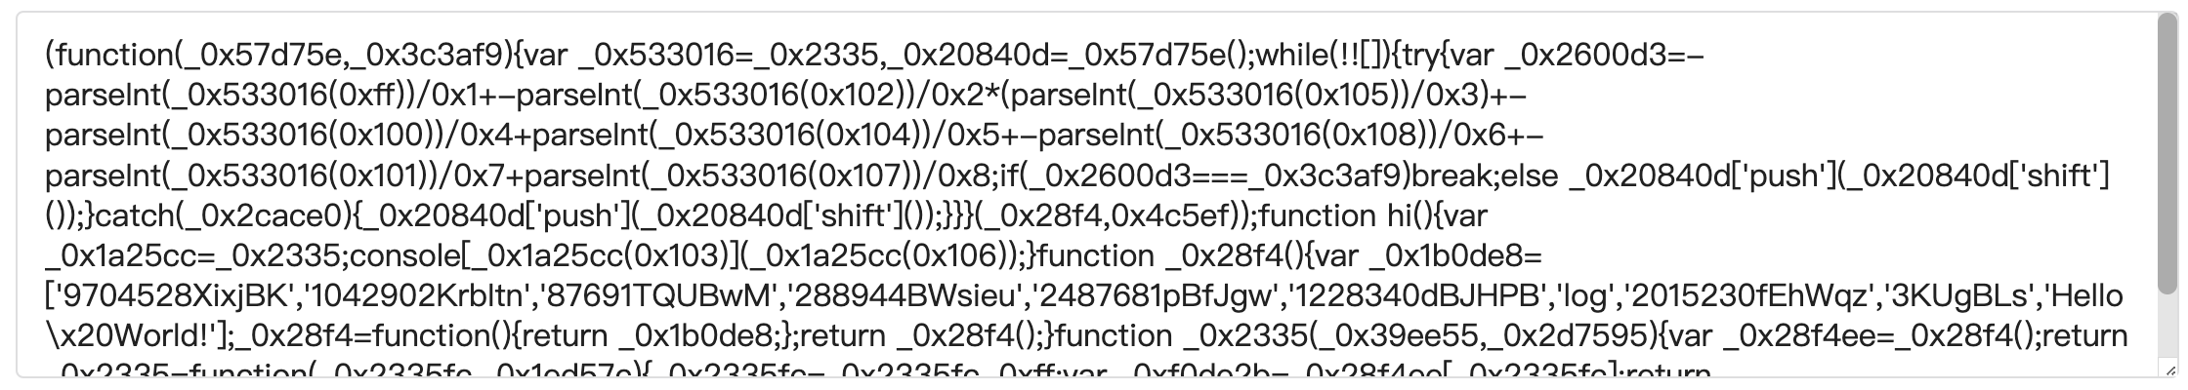
LLM + reverse engineering
Original code
Obfuscated code
Deobfuscated code
https://obfuscator.io/
https://deobfuscate.io/

Slide 7
LLM + reverse engineering
Decompilation
LLM4Decompile, Nova+, MLM
Decompiler output optimization
Renaming, annotating, structure simplification …
G-3PO, ReverserAI, DeGPT (NDSS 24)
Deobfuscation
https://www.josherich.me/llm/real-world-llm-obfuscate
JSNice
https://github.com/albertan017/LLM4Decompile
Nan Jiang, Chengxiao Wang, Kevin Liu, Xiangzhe Xu, Lin Tan, and Xiangyu Zhang. 2023. Nova+: Generative language models for binaries. CoRR, abs/2311.13721
https://mlm.lingyiwanwu.com/
https://github.com/tenable/ghidra_tools/tree/main/g3po
https://github.com/mrphrazer/reverser_ai
Hu, Peiwei, Ruigang Liang, and Kai Chen. "DeGPT: Optimizing Decompiler Output with LLM." NDSS (2024). vol. 267622140. 2024.
http://jsnice.org/

Slide 8
LLM + reverse engineering
LLM4Decompile: Decompiling Binary Code with Large Language Models
The first open-source LLM dedicated to decompilation (1B to 33B )
The first decompilation benchmark which targets re-compilation and re-execution rate
Pre-training Data
asm-source pairs based on Anghabench (one million compilable C files )
Function level
x86 Linux platform
compile the source code into all four optimization stages, i.e., O0, O1, O2, O3
Prompt:
# This is the assembly code with [optimization state] optimization: [asm code] # What is the source code?

Slide 9
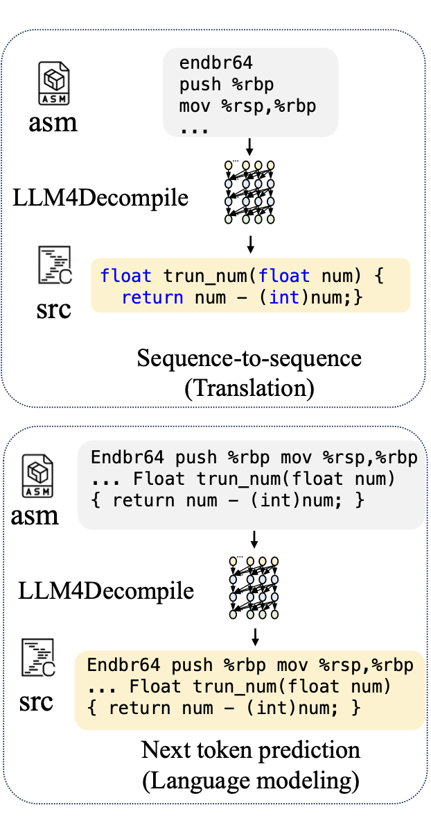
LLM + reverse engineering
LLM4Decompile: Decompiling Binary Code with Large Language Models
DeepSeek-Coder
Task1: Next token prediction (NTP)
predicting the next token given previous inputs
Task2: Sequence-to-sequence prediction (S2S)
training objective adopted in most neural machine translation models that aims to predict the output given the input sequence
Notes:
DeepSeek-Coder models (1.3B, 6.7B, and 33B)
8 NVIDIA A100-80GB GPUs.

Slide 10
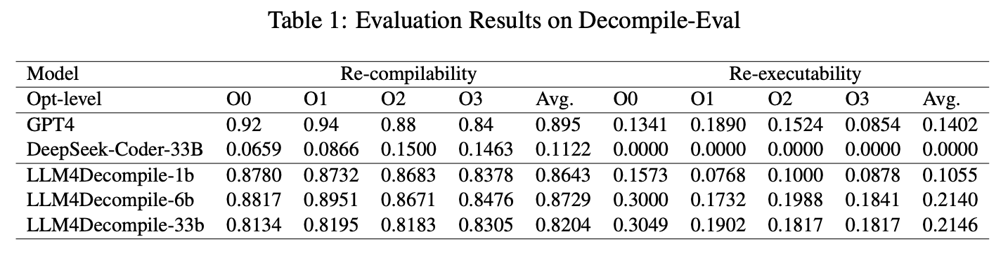
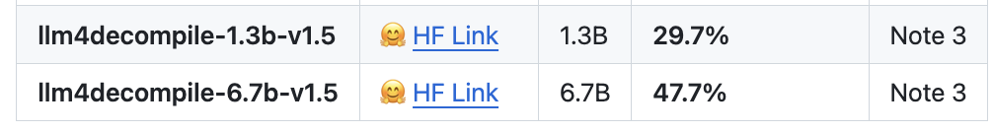
LLM + reverse engineering
LLM4Decompile: Decompiling Binary Code with Large Language Models
Metrics
BLEU and edit similarity (ES)
Re-compilability Re-executability
Decompile-Eval Benchmark
HumanEval (164 programming challenges with Python solutions and assertions)
converted Python solutions and assertions into C
Note 3: V1.5 series are trained with a larger dataset (15B tokens) and a maximum token size of 4,096, with remarkable performance (up to 100% improvement) compared to the previous model.
Notes:
6B LLM4Decompile achieved 87% re-compilability, indicating syntactic understanding,
21% re-executability(pass testcases), suggesting semantic preservation

Slide 11
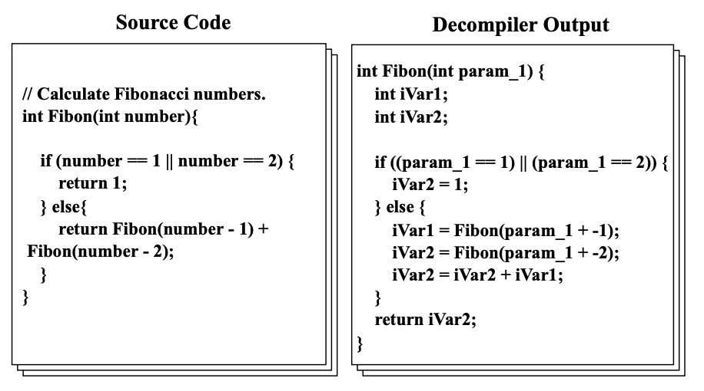
LLM + reverse engineering
DeGPT: Optimizing Decompiler Output with LLM
Redundant Structures
Meaningless Identifiers
Lacking Comments

Slide 12
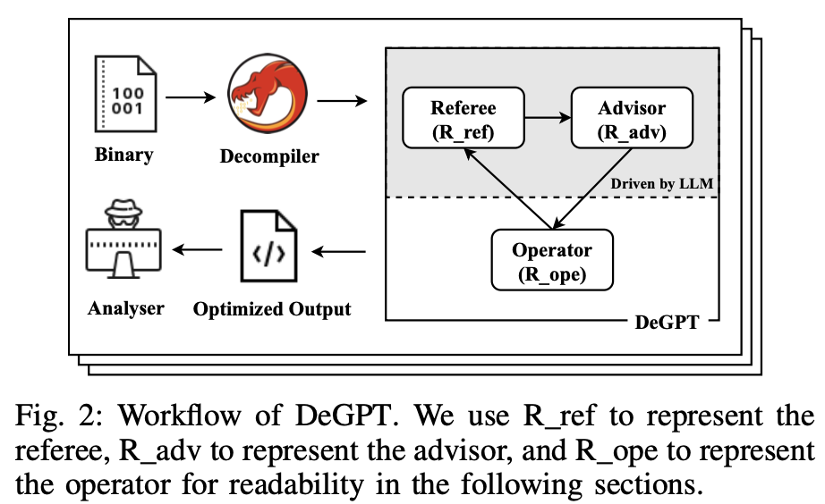
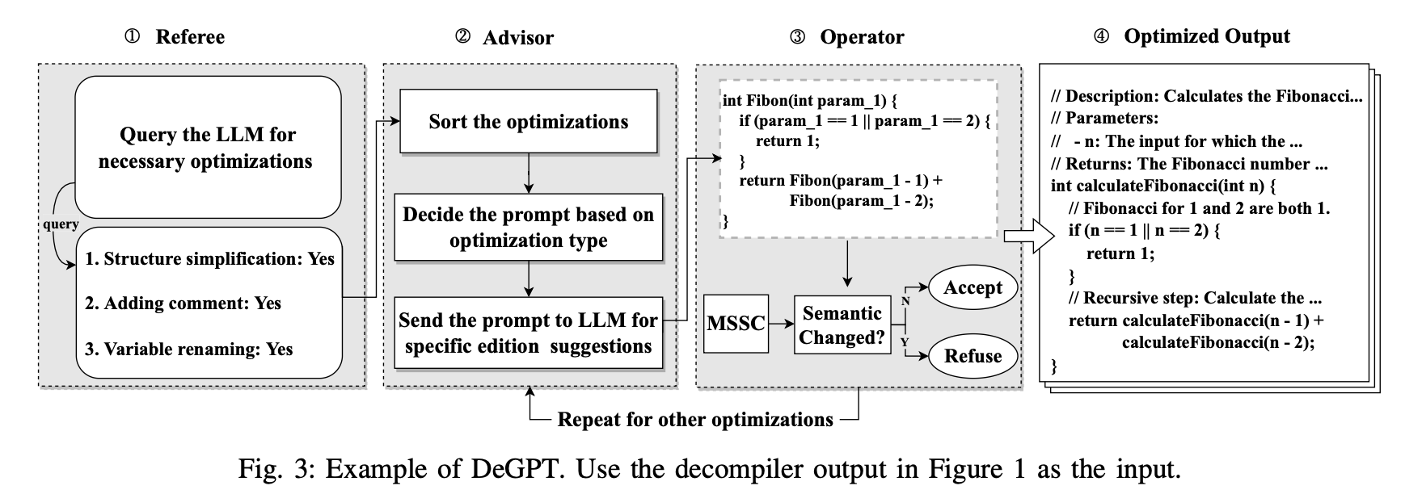
LLM + reverse engineering
DeGPT: Optimizing Decompiler Output with LLM
3 roles: R_ref, R_adv, R_ope
MSSC: collect symbols, assign random numbers, update symbol values

Slide 13
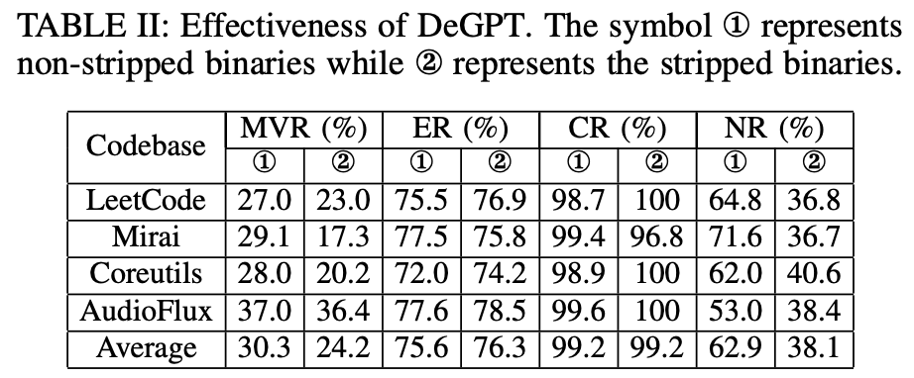
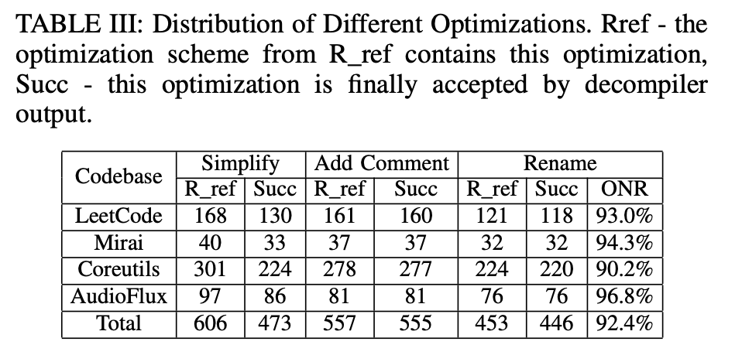
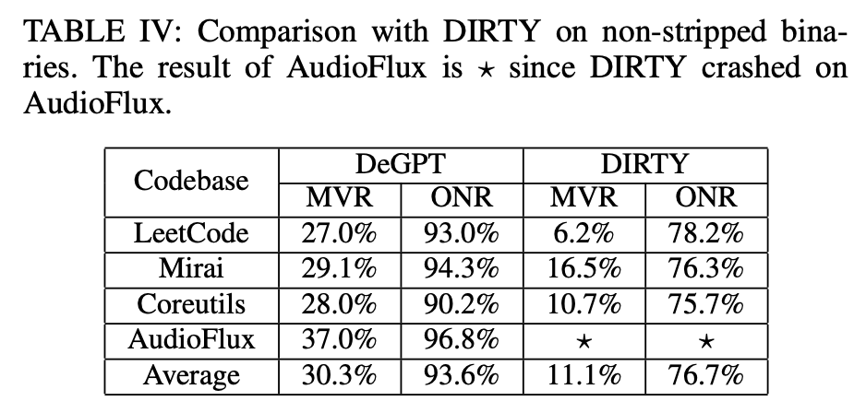
LLM + reverse engineering
DeGPT: Optimizing Decompiler Output with LLM
Metrics
Meaningful Variable Ratio (MVR):
Effort Ratio (ER) lower better
Correct Rate of Comments (CR）
Non-trivial Rate of Comments (NR）
Optimized Name Ratio (ONR)
evaluate how many variables names are newly allocated
Notes:
ChatGPT (gpt-3.5-turbo with the temperature 0.2) The compiler used for evaluation is gcc 9.4.0 and the decompiler is Ghidra 10.2.3.
Dataset
collect the code from LeetCode Coreutils Mirai and AudioFlux We choose these codebases because they are popular and representative of various fields including implementations of algorithms, practical command line tools, IoT viruses, and audio processing
620 sets of source code and decompiler outputs of functions from non-stripped and stripped binaries
Metrics
Meaningful Variable Ratio (MVR):
treat an optimized variable name meaningful if the Levenshtein distance between it and one of the variables in the source code is less than the threshold
manually construct a list of synonyms
Effort Ratio (ER)
Hastead’s Complexity Measures （based on the number of distinct operators and operands in the program）
Correct Rate of Comments (CR) manually
Non-trivial Rate of Comments (NR) manually，define a comment as trivial if it merely states the behavior of the program statement.

Slide 14
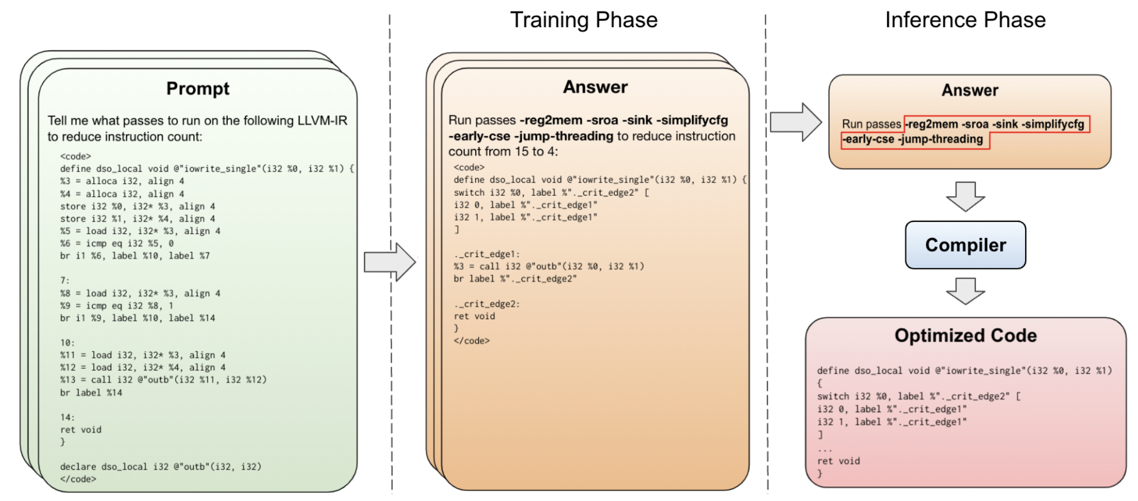
LLM + reverse engineering
Large Language Models for Compiler Optimization
The first application of LLMs to optimizing code
Find that in many cases a sufficiently trained LLM can not only predict the best optimizations to apply to an input code, but it can also directly perform the optimizations without resorting to the compiler.
Task： compiler pass ordering + auxiliary tasks (instruction counts, IR after the optimizations)

Slide 15
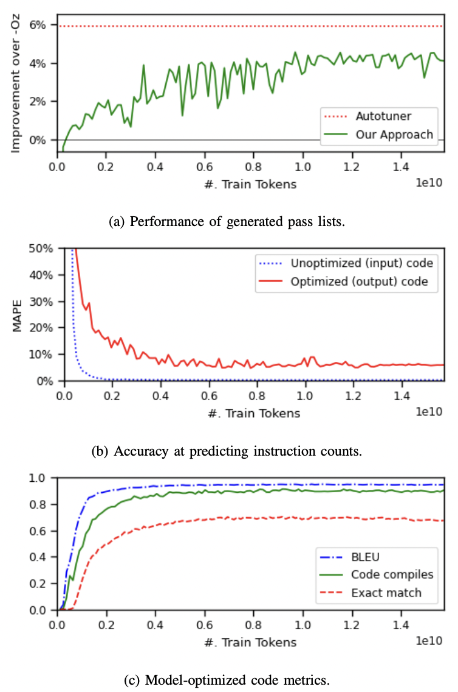
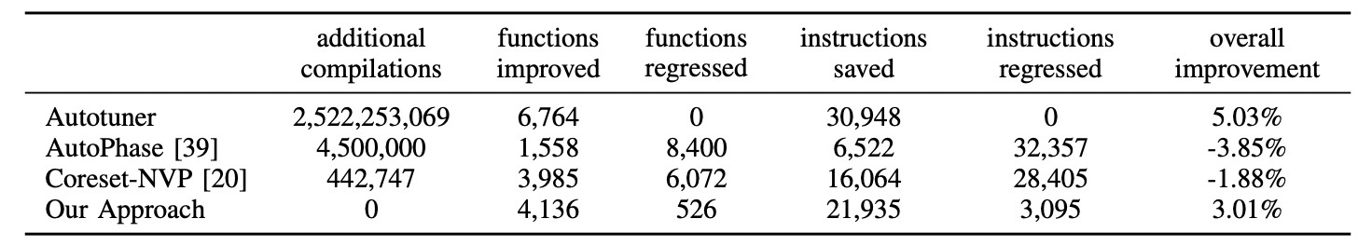
LLM + reverse engineering
Large Language Models for Compiler Optimization
4.4% fewer instructions than –Oz (autotuner 5.6%)
Prediction of output instruction count 5.9% MAPE
quality of the generated code
BLEU 0.952 （ copies the unoptimized code BLEU score is 0.531 ）
Code compiles no error 90.5%
exact match frequency 70%
outperforms -Oz, AutoPhase, and Coreset-NVP
Notes:
Model： Llama 2 7B train from scratch
Training data：1,000,000 deduplicated IR functions, totaling 373M training tokens
Use autotuning to find the list of optimization passes that will produce the smallest instruction count
（random search and all-to-all results broadcasting between functions）
AutoPhase （reinforcement learning agent to select the sequence of optimization passes）
Coreset-NVP（determine a Core set of best pass lists and train Neural Value Prediction to predict reward and pass sequences）
Autotuner
compiled each training program an average of 37,424 times, achieving a 5.8% improvement in instruction count reduction
Training：
64 V100s for a total training time of 620 GPU days

Slide 16
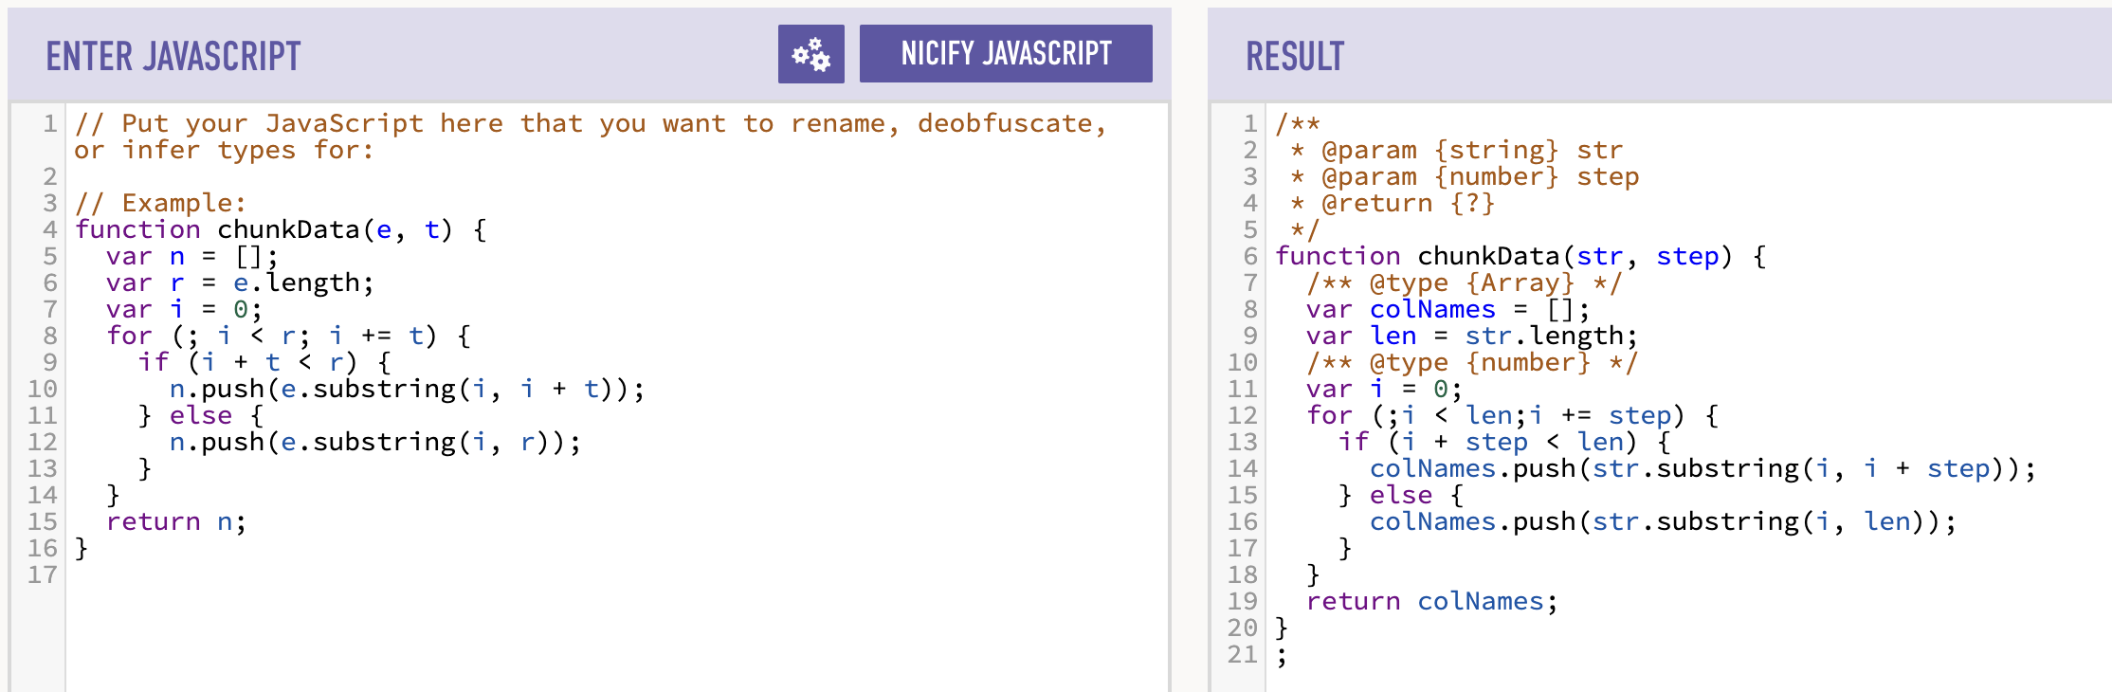
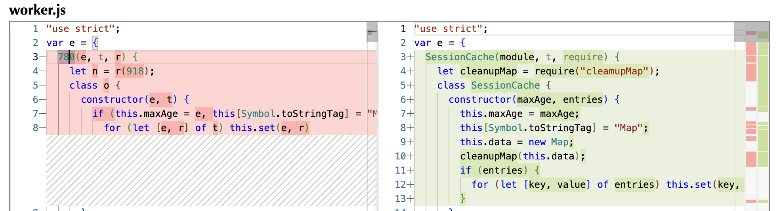
LLM + reverse engineering
Deobfuscation

Slide 17
1
LLM + reverse engineering
LLM-based Code Deobfuscation for JavaScript
2

Slide 18
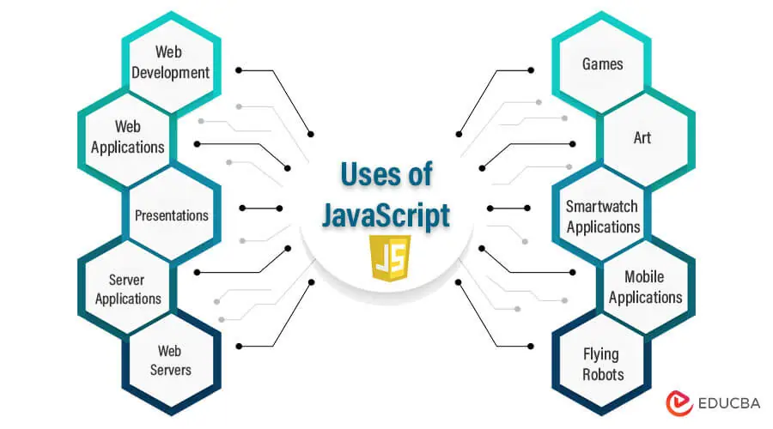








LLM-based Code Deobfuscation for JavaScript
Code Obfuscation
Intentionally make software source code difficult to understand and analyze while preserving functionality

Slide 19
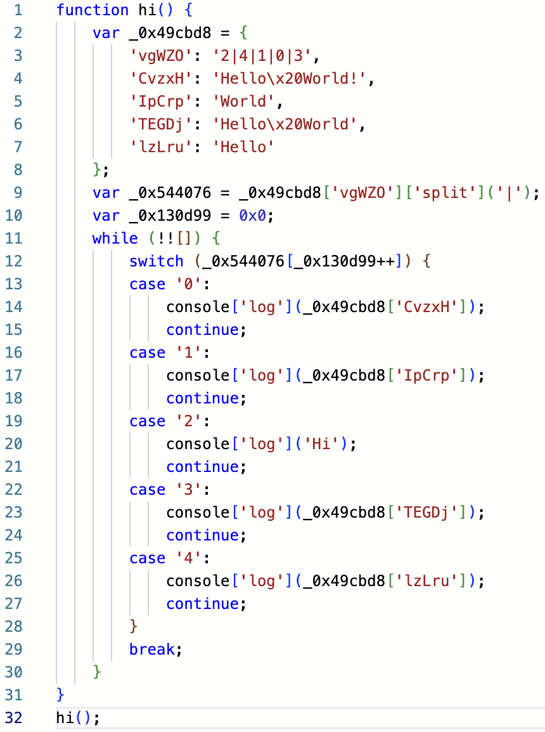
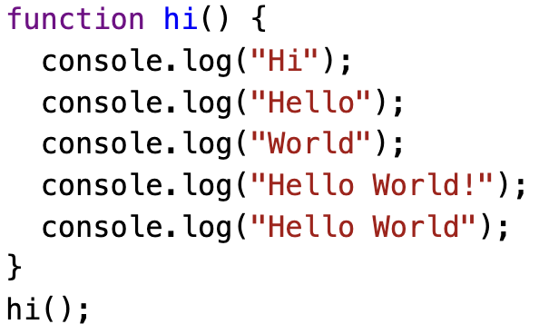
LLM-based Code Deobfuscation for JavaScript
Code Obfuscation
Intentionally make software source code difficult to understand and analyze while preserving functionality
e.g. code minification, identifier obfuscation, string obfuscation, code insertion, structure obfuscation…
An example of structure obfuscation(control flow flattening)

Slide 20
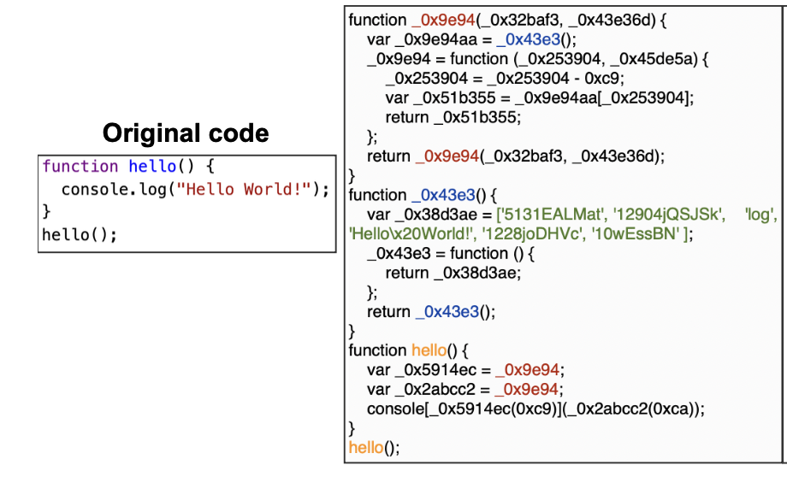
LLM-based Code Deobfuscation for JavaScript
Code Obfuscation
Intentionally make software source code difficult to understand and analyze while preserving functionality
e.g. code minification, identifier obfuscation, string obfuscation, code insertion, structure obfuscation…
An example of string obfuscation

Slide 21
LLM-based Code Deobfuscation for JavaScript
Existing methods for JS code deobfuscation
1. static rule-based method
2. dynamic or hybrid method
3. ML-based method
Limitations
1. Analyzing obfuscation patterns and developing deobfuscating rules require too much manual work. The well-defined rules can become invalid on unknown patterns. 2. Hard to provide a correct runtime environment with appropriate inputs for unknown code and attain high code coverage. And the extracted trace still contains obfuscation instructions.
3. Hard to predict names for heavily obfuscated codes, which usually introduce many temporary or dummy functions/variables. Can not generate the actual code.

Slide 22
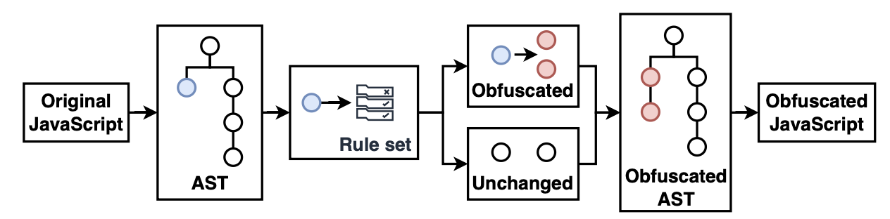
LLM-based Code Deobfuscation for JavaScript
Obfuscation is not entirely random and has some code patterns.
The workflow of obfuscation tools

Slide 23
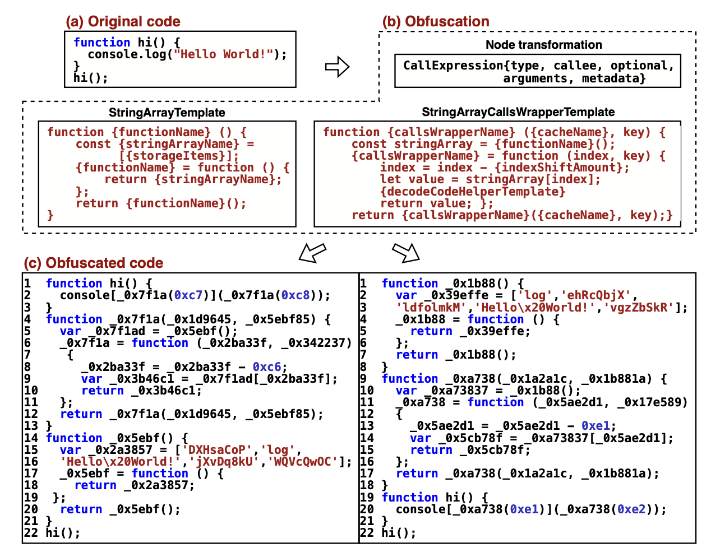
LLM-based Code Deobfuscation for JavaScript
An example of the template for string obfuscation.

Slide 24
LLM-based Code Deobfuscation for JavaScript
Potential of LLM in Deobfuscation
obfuscated code mainly consists of added code from templates and core code which corresponds to the original code.
Program analysis
core code is the entry point or at certain fixed positions? not definitely
ML
Word2vec+BLSTM distinguishing core code and added code?
86% precision and difficult to extend to statement level
LLM
100% precision and most of the output statements belong to the core code
Remark: According to the preliminary analysis results, LLMs have greater potential in JS code deobfuscation than program analysis and ML models

Slide 25
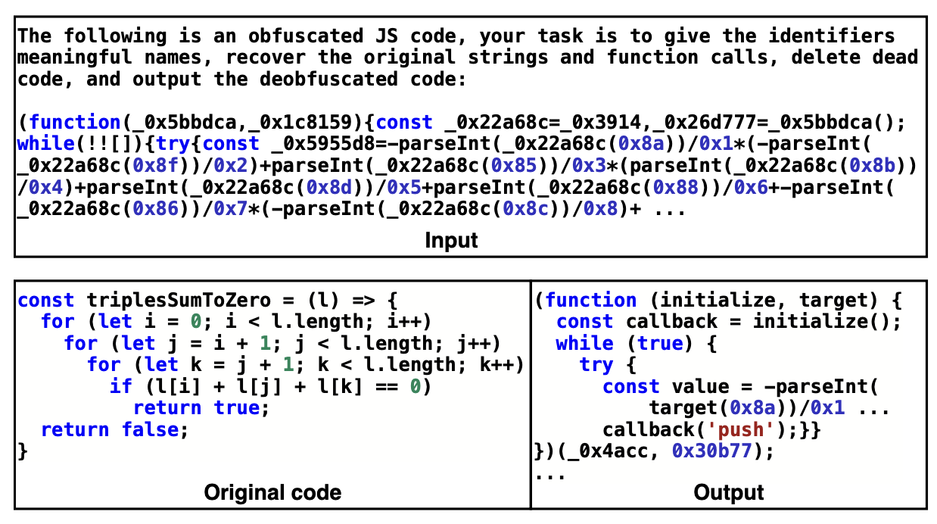
LLM-based Code Deobfuscation for JavaScript
Potential of LLM in Deobfuscation
obfuscated code mainly consists of added code from templates and core code which corresponds to the original code.
Program analysis
core code is the entry point or at certain fixed positions? not definitely
ML
Word2vec+BLSTM distinguishing core code and added code?
86% precision and difficult to extend to statement level
LLM
100% precision and most of the output statements belong to the core code
Remark: According to the preliminary analysis results, LLMs have greater potential in JS code deobfuscation than program analysis and ML models

Slide 26
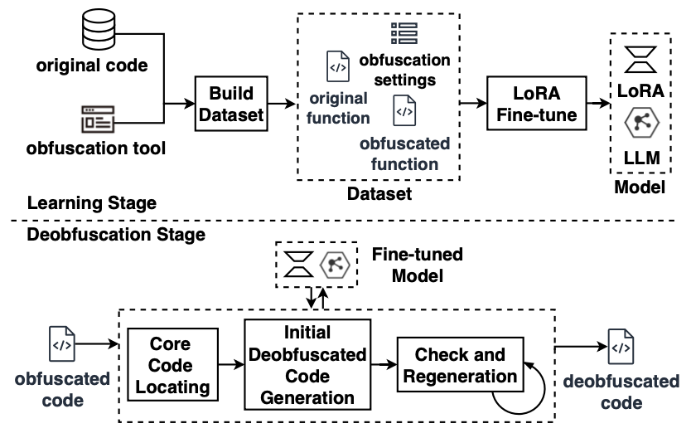
LLM-based Code Deobfuscation for JavaScript
Method
Learning Stage:
Conduct core code locating fine-tuning to identify the core code and ignore the code generated by obfuscation tools
Deobfuscation Stage:
Core code locating module
Initial deobfuscated code generation module
Check and regeneration module

Slide 27
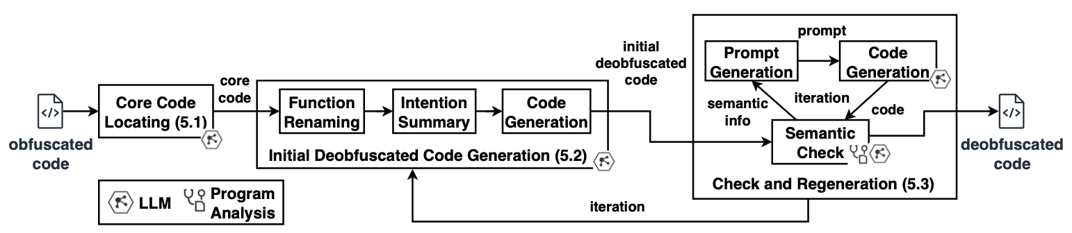
LLM-based Code Deobfuscation for JavaScript
Method
Core code locating
Locates the core code with the fine-tuned LLM.
Remove most of the code that belongs to the obfuscation template and locates and recovers the core code back to a more readable format

Slide 28
LLM-based Code Deobfuscation for JavaScript
Method
Initial deobfuscated code generation
Ask the model to interpret the intention of the core code and generate it again
The core code can help the model infer the main intention of the obfuscated code, and when generating a code to implement the intention, the model can ignore the unrelated parts, complete the missing parts, and adjust the syntax structure.

Slide 29
LLM-based Code Deobfuscation for JavaScript
Method
Check and regeneration
Attempt to generate testcases with the help of LLM
Run the testcases on the generated code and obfuscated code
If the outputs are the same, we consider the semantics to be consistent. Otherwise, the wrong output and expected output will be added to the prompt for regeneration

Slide 30
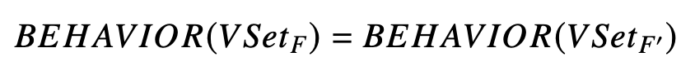
LLM-based Code Deobfuscation for JavaScript
Method
Check and regeneration
For not executable code, given function pair 𝐹 and 𝐹′, the non-local variable set of them are 𝑉𝑆𝑒𝑡𝐹 and𝑉𝑆𝑒𝑡𝐹′, we define semantic consistency as:
where 𝐵𝐸𝐻𝐴𝑉𝐼𝑂𝑅(𝑉𝑆𝑒𝑡𝐹) means the collection of actions the function 𝐹 does on the variables.
Steps:
1. Collect non-local variables 𝑉𝑆𝑒𝑡 (function parameters)
2. Build CFG and extract execution paths
3. Collect variables that get data from current 𝑉𝑆𝑒𝑡, add these variables to 𝑉𝑆𝑒𝑡
4. Record AST node type information on the paths as the representation of 𝐵𝐸𝐻𝐴𝑉𝐼𝑂𝑅.
e.g. While(a>0), AST node type information is: ”WhileStatement, test condition of WhileStatement”
5. Compare 𝐵𝐸𝐻𝐴𝑉𝐼𝑂𝑅 sequences. If two sequences are the same, take them as semantic consistent

Slide 31
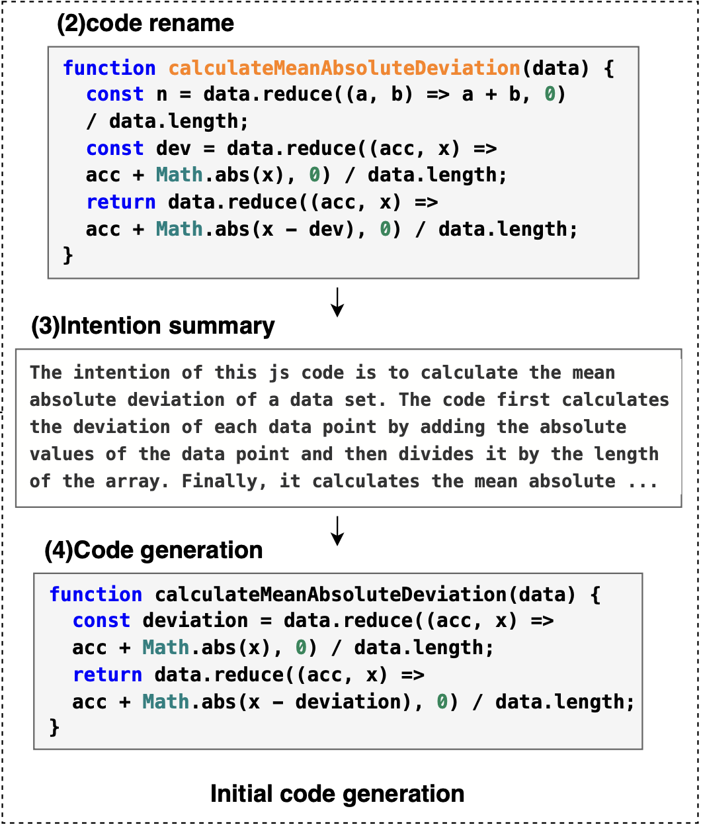
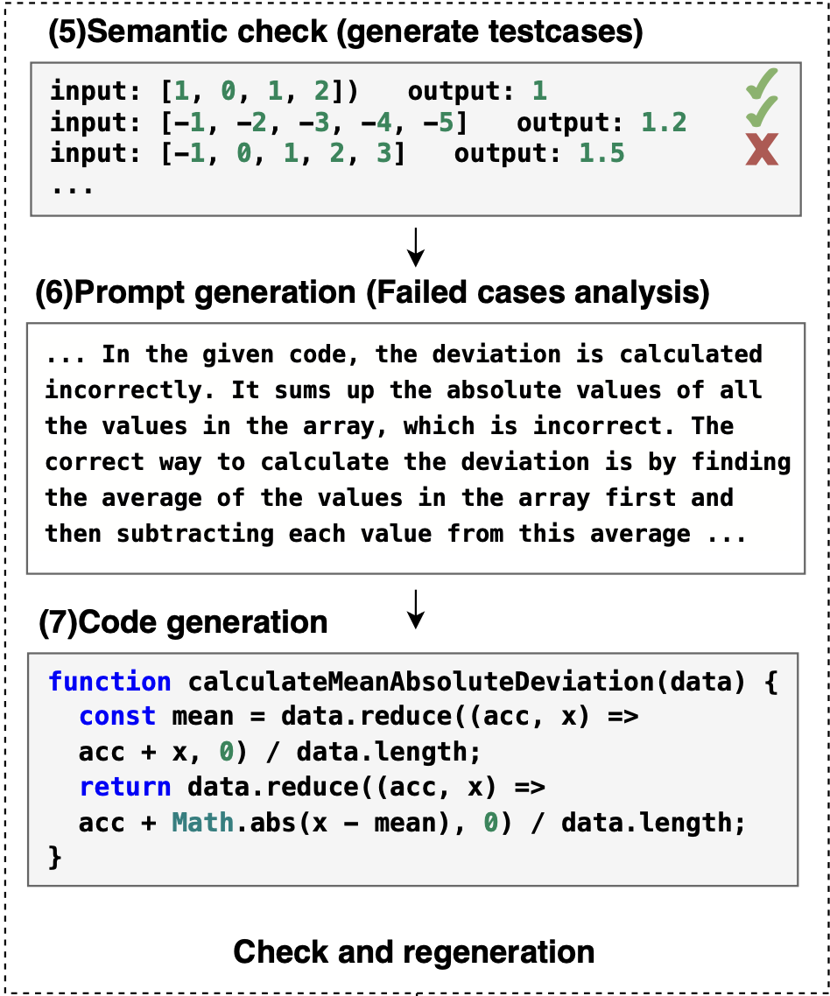
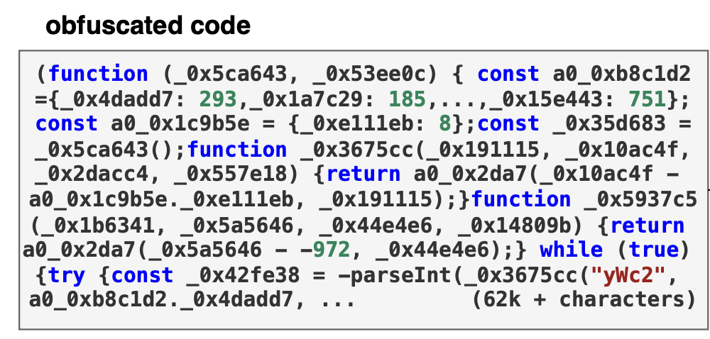

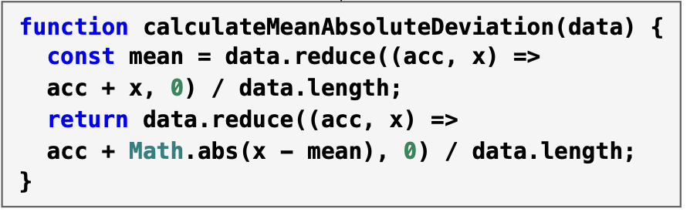
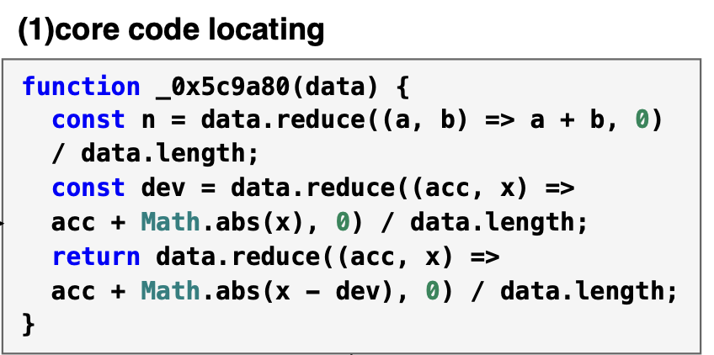
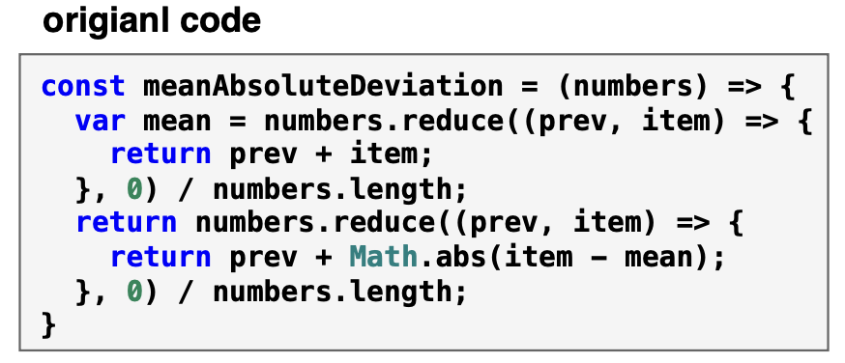
LLM-based Code Deobfuscation for JavaScript
Method
An example:

Slide 32
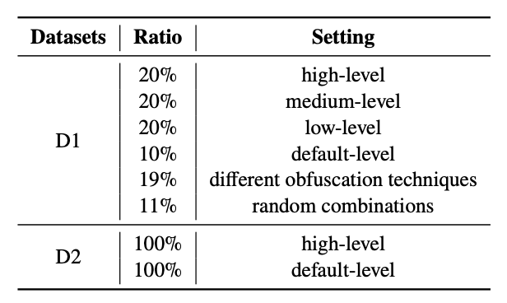
LLM-based Code Deobfuscation for JavaScript
Evaluation
Data Collection
D1 javascript code from cdnjs and NPM 158,002 obfuscated-original function pairs (2000 testing)
D2 HumanEval-X (164 javascript samples)
Obfuscate the code with different settings
Metrics
text and structure similarity
Text Edit Distance (TED), BLEU, CFG Edit Distance (GED)
semantic similarity
Vector Similarity (cos, word2vec embedding)
Input/Output equivalence (I/O)

Slide 33
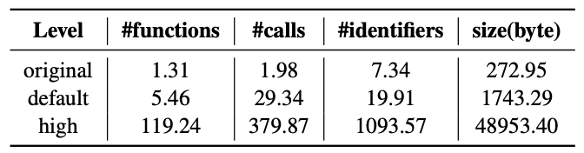
LLM-based Code Deobfuscation for JavaScript
Evaluation
Complexity of obfuscated code
Model
CodeLlama 7B Instruct
longlora
2 A100 80G GPUs

Slide 34
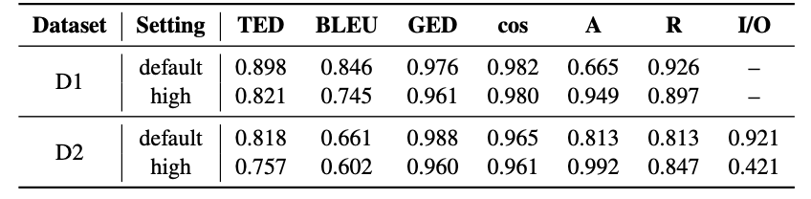
LLM-based Code Deobfuscation for JavaScript
Evaluation
Effectiveness on the testing data against different obfuscation levels
Performance on 2000 samples from D1 and D2
Can handle both low- and high-level obfuscated code. The deobfuscated code can achieve high text, structure, and semantic similarity compared with original code

Slide 35
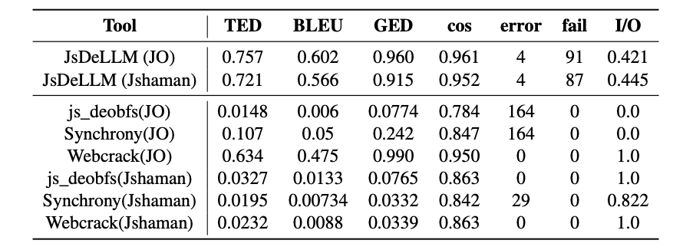
LLM-based Code Deobfuscation for JavaScript
Evaluation
Comparison with existing deobfuscation tools
Obfuscation tools:
Javascript-obfuscator(JO)
Jshaman
Deobfuscation tools:
Js_deobfs, Synchrony, Webcrack
Can recover more text and structure information compared to existing static deobfuscation tools.
Performance against another obfuscation tool and comparison with other deobfuscation tools on D2-high.

Slide 36
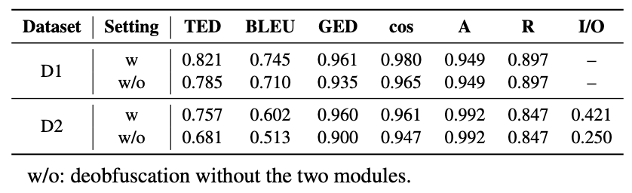
LLM-based Code Deobfuscation for JavaScript
Evaluation
Performance of the proposed modules
Initial code generation and check and regeneration modules improve the metrics by 1.5% to 3.6% for D1 and 1.4% to 17.1% for D2, the I/O is improved by 17%

Slide 37
LLM-based Code Deobfuscation for JavaScript
Conclusion
1. Propose a new JS code deobfuscation approach based on fine-tuned LLM.
2. Design a method to check semantic consistency between the obfuscated code and deobfuscated code by comparing their runtime outputs and static behavioral information.
3. Investigate the ability of LLMs on code deobfuscation tasks. The proposed approach can help handle the obfuscation challenge in malware analysis and Third-party libraries analysis.

Slide 38
Thanks!

